Slide 1
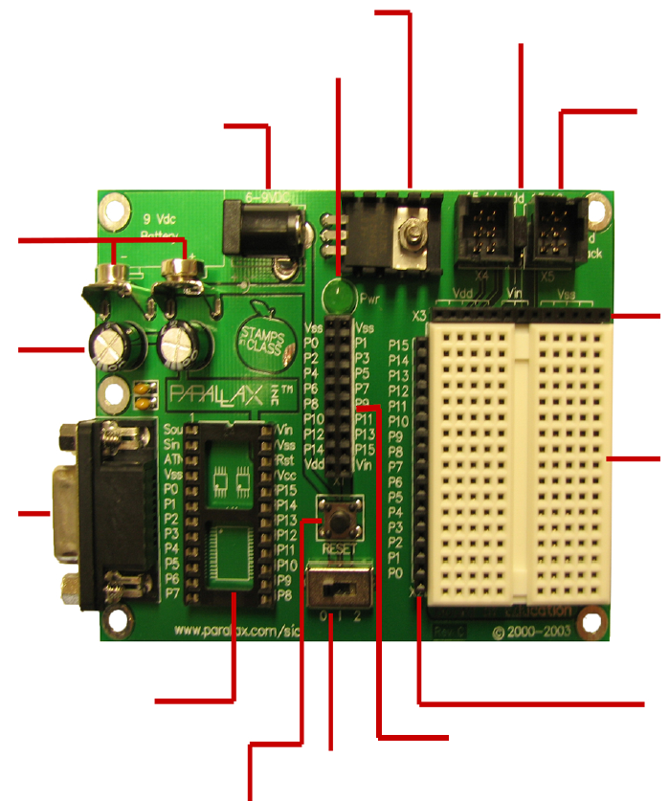
Diagram of the Board of Education
Voltage regulator supplies Board of Education
with regulated 5 VDC (Vdd) and ground (Vss)
Servo power selector:
Vdd regulated 5 VDC
Vin connects directly to the Board of Education’s power source
Power indicator light
Power jack 2.1 mm center positive 6-9 VDC
4 R/C servo connection ports
for robotic projects
9 VDC battery clip
Filter capacitors for 5 VDC regulators on Board of Education and BASIC stamp
Header for connecting power (Vdd, Vin,
Vss) to circuits on the breadboard
Breadboard rows are connected
horizontally, separated by the trough
Serial port connector for downloading PBASIC programs and debug terminal runtime communication
Socket for any 24-pin
BASIC stamp module
Header for connecting BASIC Stamp I/O
Pins to circuits on the breadboard
Application Module (AppMod) connector for add-on modules
Three-position switch
0=power OFF
1=power ON / servo ports OFF
2=power ON / servo ports ON
Reset button may be
pressed and released
to restart you BASIC
Stamp program
Based on Figure B-2 in the Parallax Robotics Book (Version 2.2)

